Slide 1

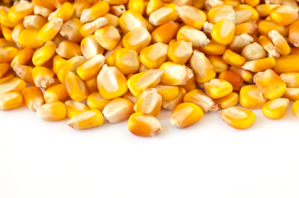
The Good, the Bad and the ugly: impacts of GE Crops in the united states
Pesticides: Domestic and International Perspectives from Science,
Law and Governance
Irvine, CA
April 12, 2012
Charles Benbrook, PhD
Adjunct Faculty, Crop & Soil Sciences, WSU
Chief Scientist, The Organic Center

Slide 2
Scientific achievements in molecular genetics, biotechnology, and plant breeding
The GOOD
Remarkably rapid adoption
A picture is worth a thousand words…

Slide 4
Remarkable commercial success
Stephen Duke and Michael Owen
on glyphosate, herbicide-tolerant technology
“…the most rapid adoption of a crop technology in the history of agriculture.”
“…the most important change in technology in the history of agriculture.”
Stephen O. Duke, 2011. “Comparing Conventional and Biotechnology-based Pest
Management,” J. Agricultural and Food Chemistry, Vol. 59, pages 5793-5798.
Michael D.K. Owen, 2011. “Weed resistance development and management in
herbicide-tolerant crops: experiences from the USA,” J. Consumer Protection and
Food Safety, Supplement 1, pages 85-89, doi 10.1007/s00003-011-0679-2

Slide 5
Roundup Ready (RR) technology largely solved
difficult soybean and cotton weed management challenges in the mid-1990s associated with the need to apply multiple, low-dose, often persistent and phytotoxic herbicides
1995 | 2002
2.7 herbicides/acre (soy) | 1.7 herbicides/acre
Tricky timing for optimal control | Wide application window, very forgiving technology
Damage from carryover and/or phytotoxicity | Few if any problems with carryover or phytoxicity

Slide 6
Huge commercial success. Profits financed
the creation of a new, hybrid, multi-billion $$
industry combining assets previously in the separate seed and pesticide industries.
Changes in patent and intellectual property law and policy created unprecedented opportunities to expand profit margins
The pesticide industry, for all intents and purposes, took over the seed industry, in the late 1980s – early 1990s
DuPont purchased the remaining shares of Pioneer Hi-Bred International for $7.7 billion in March 1999, at an 80% premium over the stock’s trading value

Slide 7
Short-term reduction in herbicide use over the
first four years of commercial use
Herbicide-tolerant (HT) corn, soybeans and cotton reduced herbicide use by 14.5 million pounds in 1996-1998, or by about 2%
Rates have risen steadily since, driven by 10% + annual increases in glyphosate rates per crop year
The 90 million pound increase in herbicide use on HT crops, just from 2010-2011, is six-times larger than the sort-lived reduction in 1996-1998

Slide 8
Sustained reductions in insecticide use in both
corn and cotton, and generally successful
mandatory resistance management plans
recommended and monitored by mostly
Independent university scientists
GE Insect Pest Management Trait | Reduction in Insecticides (pounds a.i./acre)
Bt corn for ECB & other Lepidoptera insect control | 0.06 – 0.23
Bt corn for corn rootworm and other Coleoptera insect control | 0.1 – 0.28

Slide 9
Regional, national and global environmental effects from the dramatic increase in reliance on glyphosate and other herbicides
The BAD
Glyphosate is found in 60 – 100% of rain and air samples tested in Iowa and Mississippi by the U.S. Geological Survey
Nearly every stream, river, and reservoir in heavily farmed regions contain glyphosate and its degradation products
Feng-Chih Chang, Matt F. Simcik, P.D. Capel, 2011. “Occurrence and Fate of the Herbicide Glyphosate and Its Degradate Aminomethylphosphonic Acid in the Atmosphere,” Envir. Toxicology Chem., Vol. 30, pages 548-555

Slide 10
Rapid and unprecedented increases in farmer’s seed costs, made possible by changes in intellectual property law and policy, and GE trait technology fees
 | Corn Seed | Soybean Seed
1980s | $60 - $70 / bag | $12.00 / bag
1996 | $77.70 / bag | $14.80 / bag
Today | $250 / bag | ~$45.00 - $60.00 / bag
GE cotton seed costs have risen about six-fold since 1995. GE seed cost over 30% of expected gross cotton income per acre in 2010, compared to less than 5% of gross income in the pre-GE era.

Slide 11
Shift in approximately 30% of historic net corn, soybean, and cotton income per acre from farmers to the seed-biotech-pesticide industry
Historically high crop prices since 2007 have softened the blow of rising costs of GE crop technology
?
What will happen when crop prices
return closer to historic norms

Slide 12
Herbicide-tolerant technology has dramatically accelerated the emergence and spread of resistant weeds
Over 14 million acres in the U.S. are now infested with herbicide-resistant weeds
22 weeds now resistant to glyphosate, and more than a dozen now pose an economic threat to U.S. farmers
Some weeds have evolved resistance via two or more mechanisms of resistance!!
David A. Mortensen et al., “Navigating a Critical Juncture for Sustainable Weed Management,” BioScience, Vol. 62, page 75 and
International Survey of Herbicide Resistant Weeds, www.weedscience.org

Slide 13
Herbicide-tolerant technology has triggered the emergence and spread of a boatload of multiple-herbicide-resistant weeds…farmers are not “feeling lucky”
108 biotypes of 38 weed species are simultaneously resistant to herbicides in 2 or more families of chemistry
  44% of multiple resistant weeds have appeared since 2005
  Common waterhemp in the U.S. is resistant to more than 20+ currently marketed active ingredients, including glyphosate, ALS, and PPD herbicides
David A. Mortensen et al., “Navigating a Critical Juncture for Sustainable Weed Management,” BioScience, Vol. 62, page 75

Slide 14
No major new herbicide mode of action has been commercialized in about 20 years**
Major BAD:
No quick herbicide-based fixes on the horizon
** Gerwick, “Thirty years of herbicide discovery: surveying the past and contemplating the future,” Agrow (Silver Jubilee Edition)
“…It is very unlikely that new herbicides with new modes of action will be available within ten to 15 years.”
Michael D.K. Owen, 2011. “Weed resistance development and
management in herbicide-tolerant crops: experiences from the USA,” J.
Consumer Protection and Food Safety, Supplement 1, pages 85-89, doi
\10.1007/s00003-011-0679-2

Slide 15
Genetically engineered crops have increased pesticide use in the U.S. by about 400 million pounds over the first 16 years of commercial use
HT corn, soybean, and cotton have increase herbicide use an estimated 525 million pounds, compared to what use would likely have been in the absence of HT technology
Bt corn and cotton have reduced insecticide applications by about 125 million pounds since 1996
First-generation GE crops and traits have increased overall pesticide use by about 400 million pounds (~7%) since 1996
* C. Benbrook et. al., 2012 . forthcoming “Measuring the Impact of GE Crops on Pesticide Use in the United States Using Publicly Available Data”.

Slide 16
Impacts of Bt corn and cotton on Cry protein endotoxin production
Bt Corn Traits: Major Events and Products
Product Nameª | Event | Year of Launch^{b} | Cry Protein | Targets^{c}
Syngenta Agrisure® CB | BT 11 | 1996 | Cry1Ab | Corn Borer
Monsanto YieldGard® Corn Borer | MON 810 | 1997 | Cry1Ab | European and Southwestern Corn Borers, Sugarcane Borer and Southern Cornstalk Borer
Monsanto YieldGard® Rootworm | MON 863 | 2003 | Cry3Bb1 | Western, Northern, and Mexican Corn Rootworm
Monsanto YieldGard VT™ Rootworm | MON 88017 | 2007 | Cry3Bb1 | Western, Northern, and Mexican Corn Rootworm
Monsanto Genuity™ VT Double PRO™ | MON 89034 | 2010 | Cry1A.105 Cry2Ab2 | European and Southwestern Corn Borers, Sugarcane Borer, Southern Cornstalk Borer, Corn Earworm, and Fall Armyworm
DowAgrosciences Pioneer Hi-Bred Herculex® I | TC1507 | 2003 | Cry1F | Western Bean Cutworm, Corn Borer, Black Cutworm and Fall Armyworm
Dow AgroSciences Pioneer Hi-Bred Herculex® RW | DAS 59122-7 | 2006 | Cry34Ab1 Cr35Ab1 | Western Corn Rootworm, Northern Corn Rootworm
Monsanto Genuity™SmartStax™, DowAgrosciences SmartStax™ | MON 88017 MON 89034 TC 1507 DAS 59122-7 | 2010 | Cry3Bb1 Cry1A.105 Cry2Ab2 Cry1F Cry34Ab1 Cr35Ab1 | European Corn Borer, Southwestern/Southern Cornstalk Borer, Corn Earworm, Fall Armyworm, Stalk Borers, Sugarcane Borer, Western Bean Cutworm, Western/Northern/Mexican Corn Rootworm
ª Event names for corn from National Corn Growers Association (NCGA) "Know Before You Grow®" Table 1, http://www.ncga.com/know-before-you-grow/; for cotton from Monsanto product descriptions and USEPA 2005. Some events are incorporated into more than one product.
^{b}The year that varieties containing each event were first offered for sale was taken from company websites, technology use guides, and farm press articles.
^{c}Insect targets for Cry proteins in corn from National Corn Growers Association (NCGA) "Know Before You Grow®" Table 1, http://www.ncga.com/know-before-you-grow/; in cotton from company product descriptions and USEPA 2005.

Slide 17
Bt Corn Expression Levels per Plant Tissue: Major Events and Products
Product Name | Event | Cry Protein | Plant Stage | Shoot^{b} conc. (ug/g dw) | Root conc. (ug/g dw)
Syngenta Agrisure® CB | BT 11 | Cry1Ab | mature
Monsanto YieldGard® Corn Borer | MON 810 | Cry1Ab | 2 wk post-pollination
Monsanto YieldGard® Rootworm | MON 863 | Cry3Bb1 | forage, 90 DAP | 130 | 136
Monsanto YieldGard VT™ Rootworm | MON 88017 | Cry3Bb1 | forage, R4-5 | 40 | 50
Monsanto Genuity™ VT Double PRO™ | MON 89034⁵ | Cry1A.105 Cry2Ab2 | forage, R4-5 forage, R4-5 | 18 29 | 20 16
DowAgrosciences Pioneer Hi-Bred Herculex® I | TC1507 | Cry1F | forage, R4-5 | 7.69 | 5.32
Dow AgroSciences Pioneer Hi-Bred Herculex® RW | DAS 59122-7 | Cry34Ab1 Cr35Ab1 | forage, R4-5 forage, R4-5 | 168 37.1 | 85.4 18.3
Monsanto Genuity™SmartStax™, DowAgrosciences SmartStax™ | MON 88017 MON 89034 TC 1507 DAS 59122-7 | Cry3Bb1 Cry1A.105 Cry2Ab2 Cry1F Cry34Ab1 Cr35Ab1 | forage, R4-5 forage, R4-5 forage, R4-5 forage, R4-5 forage, R4-5 forage, R4-5 | 48 19 29 9 157 33.6 | 65 21 18 5.97 84.6 18.9

Slide 18
Bt Corn Cry Protein Quantities per Land Area: Major Events and Products
Product Name | Event | Cry Protein | Plant Stage | Plants/acre | Cry/acre (lb/acre)
Syngenta Agrisure® CB | BT 11 | Cry1Ab | mature | 26,500 | 0.252
Monsanto YieldGard® Corn Borer | MON 810 | Cry1Ab | 2 wk post-pollination | 32,000 | 0.183
Monsanto YieldGard® Rootworm | MON 863 | Cry3Bb1 | forage, 90 DAP | 32,000 | 1.732
Monsanto YieldGard VT™ Rootworm | MON 88017 | Cry3Bb1 | forage, R4-5 | 32,000 | 0.551
Monsanto Genuity™ VT Double PRO™ | MON 89034⁵ | Cry1A.105 Cry2Ab2 | forage, R4-5 forage, R4-5 | 32,000 32,000 | 0.242 0.355 0.597
DowAgrosciences Pioneer Hi-Bred Herculex® I | TC1507 | Cry1F | forage, R4-5 | 32,000 | 0.097
Dow AgroSciences Pioneer Hi-Bred Herculex® RW | DAS 59122-7 | Cry34Ab1 Cr35Ab1 | forage, R4-5 forage, R4-5 | 32,000 32,000 | 2.042 0.45 2.492
Monsanto Genuity™SmartStax™, DowAgrosciences SmartStax™ | MON 88017 MON 89034 TC 1507 DAS 59122-7 | Cry3Bb1 Cry1A.105 Cry2Ab2 Cry1F Cry34Ab1 Cr35Ab1 | forage, R4-5 forage, R4-5 forage, R4-5 forage, R4-5 forage, R4-5 forage, R4-5 | 32,000 32,000 32,000 32,000 32,000 32,000 | 0.672 0.256 0.36 0.112 1.918 0.412 3.73
C. Benbrook, “A Method to Quantify Bt Cry Protein Production per Unit Area of Cropland for Commercially Significant Bt Corn and Cotton Cultivars,” forthcoming.

Slide 19
Dramatic increase in Bt Cry protein endotoxins in corn-cotton production systems…and nearby soil and aquatic ecosystems
Every acre planted to Bt corn for European corn borer control --
  Reduces Lepidoptera–targeted insecticide use by about 0.13 pounds active ingredient per acre, but also…
  Introduces 0.18 to 0.6 pounds of Bt Cry proteins per acre
Each acre planted to Bt corn for corn rootworm and other soil-borne insects --
  Reduces Coleoptera-targeted insecticide use by about 0.21 pounds per acre, but also…
  Introduces between 0.5 and 2.5 pounds of Bt Cry proteins per acre

Slide 20
On fields planted to Monsanto-Dow AgroSciences SmartStax corn
  Each plant expresses six different Bt Cry proteins, three for ECB/Lepidoptera, and three for corn rootworm/Coleoptera control
  Total expression of Bt proteins is 3.73 pounds per acre – 10-times more than the insecticides displaced (0.34 pounds active ingredient [0.13+0.21 pounds])

Slide 21
What about Bt crop endotoxin production compared to natural levels of Bt in soil
?
Natural Bt Soil Microorganisms | Bt Cotton | Bt Corn
0.25 g/ha* | 400 – 1000 g/ha | 2,800 – 4,200 g/ha
Bt cotton produces up to 4,000 times more Bt than soil microorganisms, while Bt corn produces up to 16,800 times more
* Blackwood, C.B., J.S. Buyer, 2004. “Soil Microbial Communities Associated with Bt and Non-Bt Corn in Three soils,” J. Environmental Quality, Vol. 33, pages 832-836
Notes:
Why worry?

Slide 22
Clear evidence that Bt resistance is emerging in multiple Cornbelt corn rootworm populations
?
Why? Bt corn for rootworm control produces only a moderate dose….and over 41% of corn farmers did not comply with mandatory Bt corn resistance-management provisions in 2010
http://www.businessweek.com/news/2012-02-09/gene-modified-corn-violations-triple-among-u-s-farmers.html
“Insufficient planting of refuges and non-recessive inheritance of resistance may have contributed to resistance. These results suggest that improvements in resistance management and a more integrated approach to the use of Bt crops may be necessary.”
Aaron J. Grossman et al., 2012. “Field-Evolved Resistance to Bt Maize by Western Corn Rootworm,” PlosOne, Vol. 6, pages 1-7
Notes:
Why worry?

Slide 23
Growing economic costs associated with GE “adventitious presence” (AP) in non-GE, organic, and identity-preserved corn, soybean, and alfalfa crops, grain and seeds
Testing costs
BMPs to prevent pollen flow and seed contamination
Market disruption and loss of premiums in high-value, GE-sensitive markets
Notes:
Why worry?

Slide 24
Concern along the corn value chain over Syngenta’s high-amylase GE corn
Developed to facilitate conversion of corn to ethanol, but also alters corn functional traits in food manufacturing at a reported 1 in 10,000 contamination level
High amylase corn is …”an accident waiting to happen”
Lynn Clarkson, member, AC 21 Agricultural
Biotechnology Advisory Committee
Notes:
Why worry?

Slide 25
First-generation GE corn has undermined 30 years of progress in Integrated Pest Management (IPM), increasing the cost of pest management and enhancing the risk of serious crop losses
“Within the past 14 years, producers have transitioned from a traditional IPM paradigm (scouting, use of thresholds, and rescue treatments) to that of a less integrated and more insurance-based approach to insect management…”
Michael E. Gray, 2011. “Relevance of Traditional Integrated Pest Management (IPM) Strategies for Commercial Corn Producers in a Transgenic Agroecosystem: A Bygone Era?” J. Agricultural and Food Chemistry, Vol. 59, pages 5852-5858
Notes:
Why worry?

Slide 26
Nine reasons contemporary Bt corn technology is incompatible with the principles of IPM
Prophylactic treatment not reliant on scouting and thresholds.
Inability to target treatments to parts of fields with populations exceeding economic thresholds.
Toxin expressed throughout the production season, and not just when insects are most vulnerable or actively feeding.
Toxin expressed throughout plant, including tissues that are not fed upon by a target insect.
The technology is dependent on single, or closely related toxins, increasing risk of resistance and/or cross-resistance. [continued…]
Notes:
Why worry?

Slide 27
Nine reasons contemporary Bt corn technology is incompatible with the principles of IPM
High probability of sub-lethal doses of Bt endotoxins in some corn plant tissues during parts of the season, increasing resistance risk.
Dependence on a single mode of action.
Technology marketed as a complete solution, downplaying the need for other tactics.
Presence of Bt genes/toxins in most elite corn hybrids denies farmers the choice of a non-Bt variety (some 40% of corn producers surveyed in 2009 reported inability to find high-yield potential elite varieties without the Bt gene [Grey, 2011. JAFC, Vol. 59]).
Notes:
Why worry?

Slide 28
Five factors that would markedly strengthen the argument that Bt corn and cotton are compatible with IPM
Fall scouting to determine likely pest pressure in the subsequent season, coupled with adherence to economic thresholds prior to planting of a Bt or other transgenic variety.
Insect-feeding damage is required to trigger production of the defensive response, i.e. Bt toxins in the case of Bt corn or cotton. (So, in the event of no or very low pressure, the plant expends no energy on the biosynthesis of Bt proteins, nor would any transgenic proteins enter the environment).
Bt toxin expression is limited to the tissues under attack, and subsides once insect feeding ends. [continued….]
Notes:
Why worry?

Slide 29
Factors strengthening the case that Bt corn and cotton are compatible with IPM
The dose of Bt toxins delivered to a typical feeding insect meets the EPA Scientific Advisory Committee definition of a “high dose,” assuring that over 99% of insects are killed, and thereby minimizing the risk of resistance.
Mandatory resistance-management plans are specified by independent university-based entomologists and are adhered to by farmers. When evidence of resistance emerges, resistance-management plan provisions are tightened for the next planting season, sufficient to stop the progression to fully resistant populations.
All five of the above criteria are now, or will likely become technically feasible within a decade
Notes:
Why worry?

Slide 30
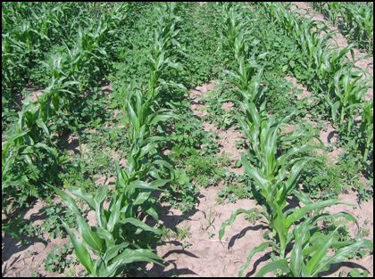
The UGLY
The resistance clock is ticking, fast
“You guys are three years behind us. This is exactly what we looked like three years ago.”
Message to Iowa HT corn-soybean farmers from Jason Northsworthy, University of Arkansas weed scientist, after inspecting row-crop fields in central Iowa
Pam Smith, “New Options for Managing Weeds in Corn,” DTN/Progressive Farmer, March 21, 2012, access at http://www.dtnprogressivefarmer.com/dtnag/common/link.do;jsessionid=59AC1FEF13F3377B66DF0F0ABAC9825A.agfreejvm1?symbolicName=/free/crops/news/template1&product=/ag/news/production/features&vendorReference=0702DAAF&paneContentId=70115&paneParentId=70104

Slide 31
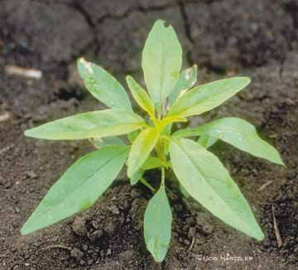
Waterhemp resistant to five herbicide modes of action are expected in 2012
Few, if any, viable chemical options will remain
Non-chemical options are costly and require significant system changes -
Return to rotations
Use of heavy tillage to bury weed seeds
Planting of cover crops
Mechanical cultivation and/or hand weeding

Slide 32
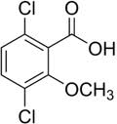
Industry push to market next-generation 2,4-D, dicamba, and paraquat herbicide-tolerant crops
High-risk gamble, like pouring gasoline on a fire to put it out
Five weed scientists on second-generation HT crops –
“...we expect that synthetic auxin-resistant (2,4-D, dicamba) cultivars will be embraced by growers and planted on rapidly increasing areas in the United States and worldwide over the next 5-10 years.”
David A. Mortensen et al., “Navigating a Critical Juncture for Sustainable Weed Management,” BioScience, Vol. 62

Slide 33
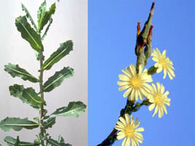
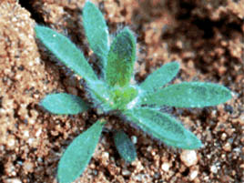
…and in response to claims that there are “very few” weed species currently resistant to synthetic auxin herbicides…
“Globally, there are 28 species [resistant to 2,4-D and dicamba], with 6 resistant to dicamba specifically, 16 to 2,4-D, and at least 2 resistant to both active ingredients.”
“…the potential for synthetic auxin-resistant or combined synthetic auxin- and glyphosate-resistant weeds in transgenic cropping systems is actually quite high.” [Emphasis added]
David A. Mortensen et al., “Navigating a Critical Juncture for Sustainable Weed Management,” BioScience, Vol. 62
Notes:
Top – prickly lettuce (resistant to dicamba 2-4,D (Washington)
Bottom – Kochia (resistant to dicamba (Idaho)

Slide 34
73-fold increase in the pounds of 2,4-D applied to corn could occur by 2019, compared to the low-point in 2,4-D corn use in 2002 (4% of acres treated)
Notes:
Top – prickly lettuce (resistant to dicamba 2-4,D (Washington)
Bottom – Kochia (resistant to dicamba (Idaho)

Slide 35

Key parameters in projecting the increase of 2,4-D use on 2,4-D HT corn
Dicamba-tolerant corn is not approved or marketed
Adoption peaks at 55% in 2019 (nat’l)
Average rate of application increase from 0.35 pound in 2010 to 0.6 pounds
Average number of applications increase from 1.1 in 2010 to 2.3 in 2019
All acres planted to HT 2,4-D corn varieties WILL be sprayed with 2,4-D

Slide 36
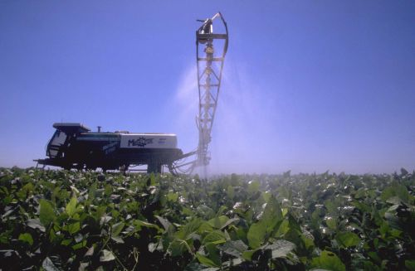
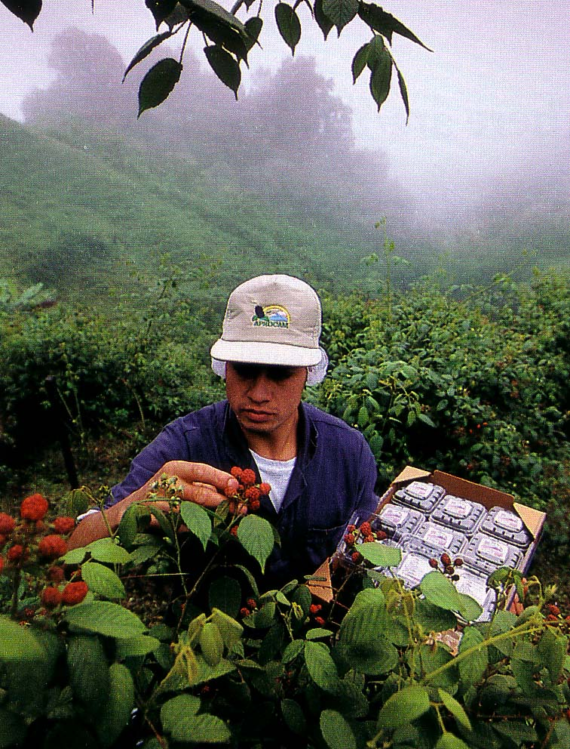
Economic damage and neighbor-to-neighbor problems caused by the off-target movement of 2,4-D and dicamba applied on second-generation HT crops
“2,4-D drift and volatilization has already become a huge problem on my farm. It has now become an annual occurrence causing significant damage to my farm. Not even the state chemist can determine where this volatilization comes from.”
Dave Simmons, Indiana farmer and member of the Save Our Crops Coalition (SOCC)

Slide 37
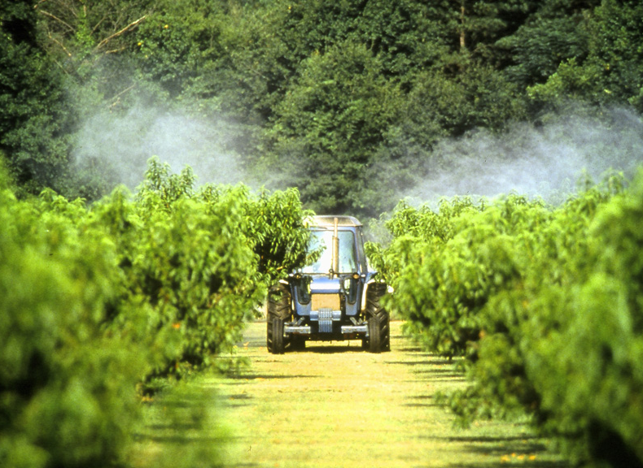
Drift and volatilization of 2,4-D and dicamba
Even without 2,4-D HT crops, 2,4-D is the #1 cause of crop damage episodes investigated by state departments of agriculture
2,4-D HT crops will vastly worsen problems because of higher rates and applications later in the crop season
“Our company was decimated by an instance of 2,4-D exposure. We continue to try to regain the confidence of our customer base, but it may never be the same. I have joined this coalition to see that no other specialty crop producer has to endure the devastation that our farm has experienced.”
Gary Phillips, a Kentucky tree farm
and SOCC member )

Slide 38
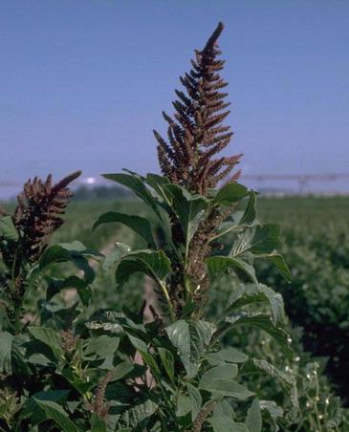
Dealing with the collateral damage from 2,4-D and dicamba applications on second-generation HT crops
“The acrimony in rural areas will be a major concern as this drift damage occurs. To solve the glyphosate resistant weed problem, we will have to pay a big price and that price will be primarily borne by those who receive little or no benefit from the herbicide application.”
Doug Doohan, Associate Professor
at Ohio State University

Slide 39


Courts will have a very hard time dealing with 2,4-D and dicamba drift and damage cases
“Our courts and communities are already struggling with the divisive affects of spray drift from genetically altered crops. Right now, this issue is pitting neighbor against neighbor.
“The volatilization issues associated with 2,4-D and dicamba make tracing the source of applications more difficult, and proving liability even for those with devastated crops is costly and uncertain.”
Jean Ann Sieler, an attorney representing growers involved in herbicide drift damage litigation in Michigan and Ohio.

Slide 40

Economic damage and neighbor-to-neighbor problems from 2,4-D and dicamba movement
Quotes from Save Our Crops Coalition, Press Release, April 2, 2012, and website, access at www.saveourcrops.org

Slide 41
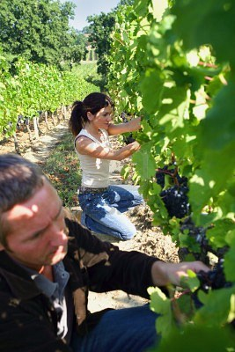
Environmental and public health problems in the wake of massive increases in synthetic auxin herbicide use
Multiple studies link 2,4-D applications in the spring to reproductive problems, spontaneous abortions and birth defects 6-9 months later
Farm workers in California employed by operations spraying 2,4-D had dramatically elevated risk of non-Hodgkin’s lymphoma (NHL) (odds ratio = 3.8), with female workers facing higher risks
Paul K. Mills, Richard Yang, Deborah Riordan, 2005. “Lymphohematopoietic cancers in the United Farm Workers of America (UFW), 1988-2001,” Cancer Causes and Controls, Vol. 16, pages 823-830

Slide 42

Near-complete failure by government, industry, and farm groups to forestall or prevent herbicide resistance in the face of its virtual certainty
“Farmers are ‘working on the advice largely of industry anymore…Public research is dead; it’s decimated.’”
Troy Roush, Indiana farmer and VP of the American Corn Grower’s Association

Slide 43
“…the problems associated with GE [genetically engineered] HT [herbicide-tolerant] crops and HR [herbicide-resistant] weeds seem to be largely without resolution attributable, in part, to the general unwillingness of growers to recognize the implications of their management tactics, the unrealistic marketing by the herbicide and seed industries, and the erroneous belief that new technologies and tactics will be available in the short-term future.”
Michael D.K. Owen, 2011. “Weed resistance development and management in herbicide-tolerant crops: experiences from the USA,” J. Consumer Protection and Food Safety, Supplement 1, pages 85-89, doi 10.1007/s00003-011-0679-2

Slide 44

Industry’s near-total success in blocking independent research on GE, pest-management related traits and systems
GE seed “technology agreements” must be signed when purchasing seed, and all provisions are binding. Most agreements contain language to the effect that –
  “This seed is for commercial use by farmers growing crops, and may not be used for any research purpose. Use in any trial or study comparing performance to other corn/soybean/cotton varieties is prohibited.”

Slide 45

The loss of an independent seed industry dedicated to solving production problems through varietal development
From the 1950s – 1990s, the major goal of plant breeding research was solving problems confronting farmers, while increasing yield and crop quality
Beginning in late 1990s, the focus has been on commercializing patentable pest-management-related traits
Most universities have essentially ended plant breeding work, except 1-3 crops per state, and only in a handful of states

Slide 46
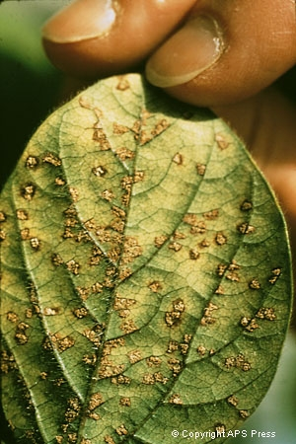
Growing evidence of heightened vulnerability of corn and soybeans to a range of plant pathogens, insect, weed, and plant nutrition problems
Declining plant health triggered by changes in genetics, planting densities, and crop management during the GE crop era
2010 – 11% corn was treated with fungicide (NASS-USDA data)
Less than 1% of corn acres were treated with fungicides in all previous NASS surveys
Notes:
Both corn and soybeans have been plagued by a series of new pathogen and soil micronutrient-related problems caused by changes in soil microbial communities in fields sprayed multiple times with glyphosate.

Slide 47
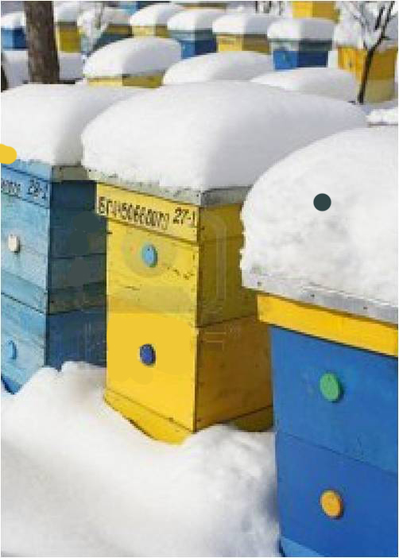
Unprecedented escalation in the breadth and toxicity of seed treatments
Nicotinyl seed treatments critical in protecting farmers investment in Bt corn for rootworm (CRW) control
  Lack of a lethal dose of Bt toxin in root tissues early in the growing season
Virtually 100% of conventional corn seed treated with a systemic nicotinyl insecticide, plus one to three fungicides
  Nicotinyl seed treatments are likely important missing piece of the honeybee Colony Collapse Disorder (CCD) puzzle
Notes:
Both corn and soybeans have been plagued by a series of new pathogen and soil micronutrient-related problems caused by changes in soil microbial communities in fields sprayed multiple times with glyphosate.

Slide 48
Reliance on systemic seed treatments lead to novel exposure pathways for a wide range of non-target organisms (bees, livestock, aquatic invertebrates, people)
Mixing multiple active ingredients in seed treatments increases the risk of resistance emerging in a variety of soil borne insects
Michael E. Gray, 2011. “Relevance of Traditional Integrated Pest Management
(IPM) Strategies for Commercial Corn Producers in a Transgenic Agroecosystem:
A Bygone Era?” J. Agricultural and Food Chemistry, Vol. 59, pages 5852-5858
Notes:
Both corn and soybeans have been plagued by a series of new pathogen and soil micronutrient-related problems caused by changes in soil microbial communities in fields sprayed multiple times with glyphosate.

Slide 49
THE future
?
Next-generation transformation technologies likely to be safer and more predictable

Slide 50
THE future
?
Some next-generation traits likely to deliver meaningful benefits for the environment and consumers, but…

Slide 51
THE future
The seed-biotech-pesticide industry has failed to win public trust and skepticism is growing over unfulfilled promises, exaggerated claims (e.g., average doubling of corn yields by 2030), and the adequacy of safety testing.

Slide 52
THE future
The public debate over second-generation 2,4-D and dicamba HT crops will likely have a significant, lasting impact on farming systems, regulatory policy, and the PR landscape here and abroad

